Slide 1



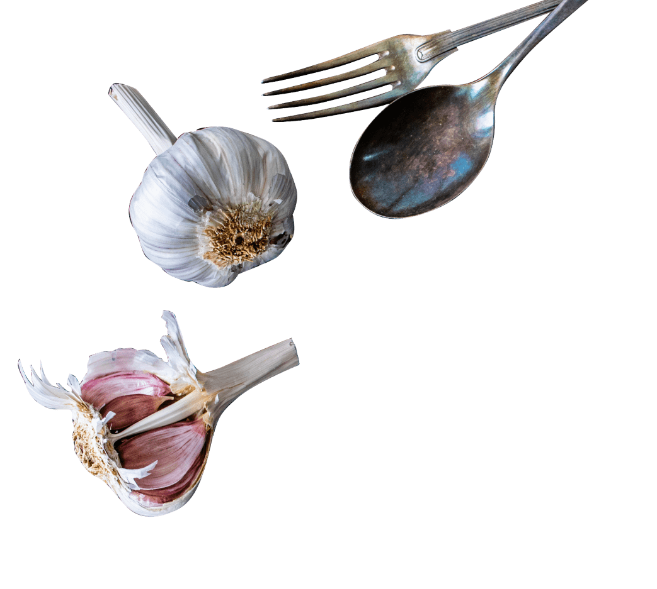

Microsoft
Access Database
🍽 SmartBite –
Online Food Delivery DBMS
01
02
03
A complete company-level Microsoft Access DBMS project
Designed for food delivery business analysis & management

Slide 2
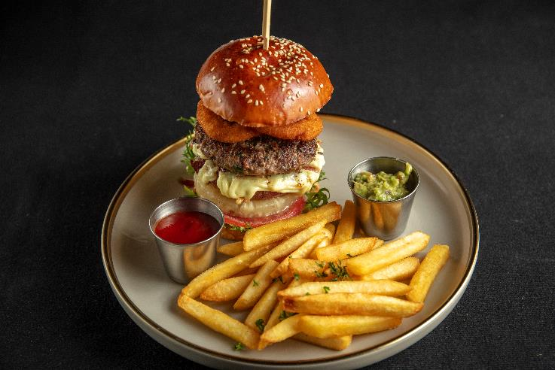
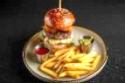
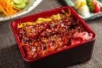

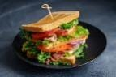
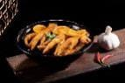
Introduction
Microsoft
Access Database
Comprehensive Microsoft Access Database System
Built for managing online food delivery operations
Handles large datasets, real-time reporting, and automation
Add Text

Slide 3


Microsoft
Access Database
Why SmartBite?
✅ SmartBite centralizes & automates everything
01.
A
02.
B
❌ Disorganized, scattered order files
❌ Manual & error-prone reporting
03.
C
04.
D
❌ No insights into loyal vs regular customers
❌ Inconsistent payment & cancellation records

Slide 4
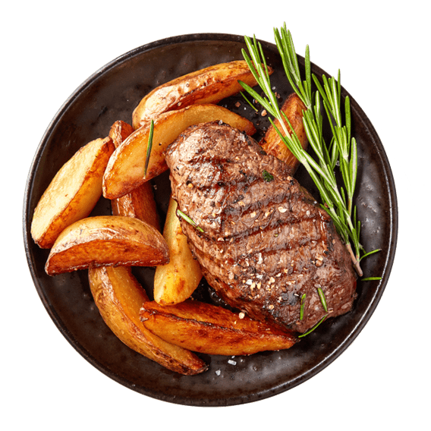

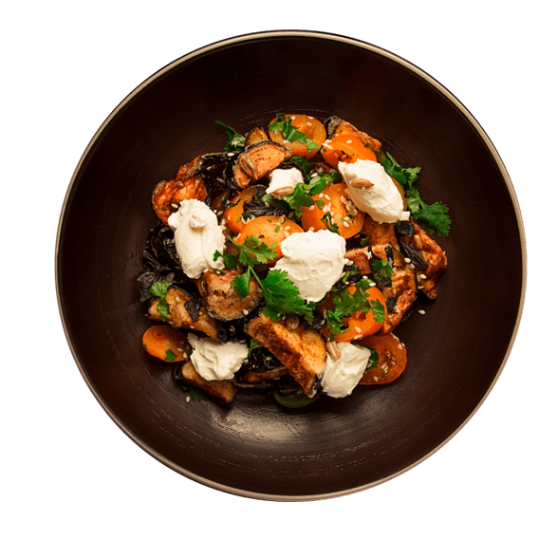

Project Purpose
Microsoft
Access Database
01
02
03
04
Solve real-world business pain points
Centralize monthly order data
Ensure data consistency & accuracy
Deliver automated revenue & sales insights

Slide 5

Key Objectives
Microsoft
Access Database
Analyze sales, cancellations & customer behavior
Generate professional reports
Calculate Revenue, Discounts, Commissions
Build master tables (Food, Customers, Restaurants)
Manage monthly transactions (Jan–Apr)

Slide 6
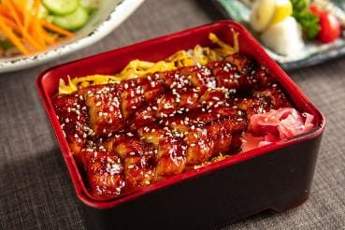
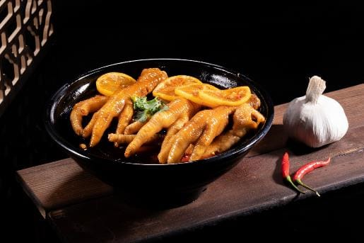



Core Features
Microsoft
Access Database
Unified AllOrders dataset
Payment mode analysis
Month-wise sales growth trends
$ 321 usd
core features
Revenue, cancellation & loyalty insights
Validation & automation rules

Slide 7
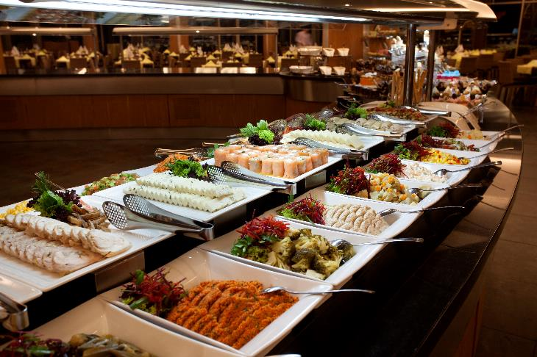



Database Structure
Microsoft
Access Database
-Food Items Table (₹150–₹350 range)
-Customers Table (Gold / Regular Members)
-Restaurants Table (Cloud, Dine-In, Takeaway)
-Monthly Orders (Jan–Apr)
-Final AllOrders merged table

Slide 8
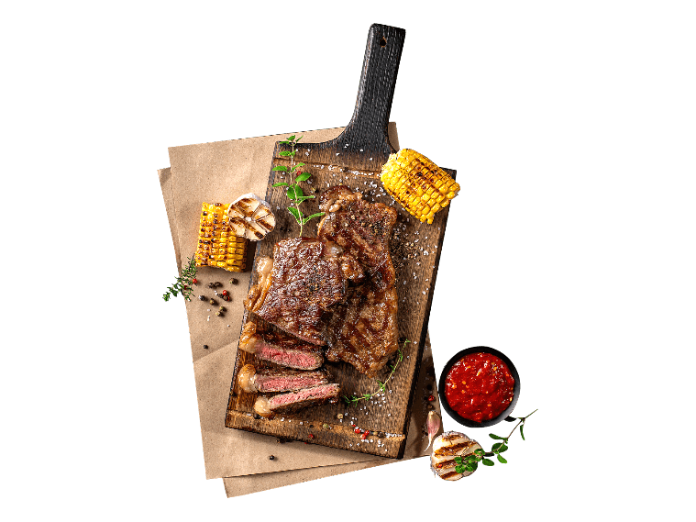


Relationships
Microsoft
Access Database
Each Order → Valid Food Item
Referential integrity applied
Each Order → Valid Customer
No orphan records
Each Order → Valid Restaurant

Slide 9


Validation Rules
Microsoft
Access Database
Prevent negative quantities
Restrict status (Delivered, Cancelled, In-Process)
$ 321 usd
Rules
Rules
Allow only vAuto-generated unique Order IDsalid payments (Cash, Card, UPI, Wallet)
Auto-generated unique Order IDs
$ 321 usd
Rules
Rules

Slide 10






Business Problems Solved
Microsoft
Access Database
YOUR LOGO
Sales Analysis (Top 5 food items)
Gross vs Net Revenue insights
short
description
Cancellation trends by item/restaurant
Gold vs Regular customer analysis
Payment method reliability

Slide 11
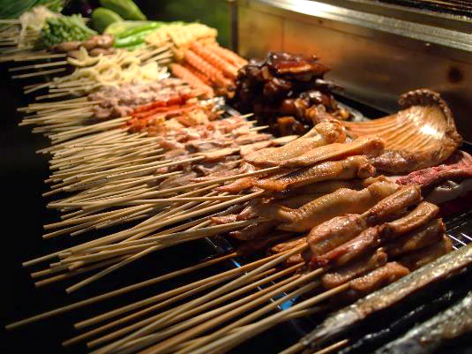



Key Calculations
Microsoft
Access Database
Gross Revenue = Quantity × Price
Discount = 10% for Gold Members
Net Revenue = Gross – Discount
Commission = 20% of Net Revenue
Cancellation % = Cancelled ÷ Total × 100

Slide 12
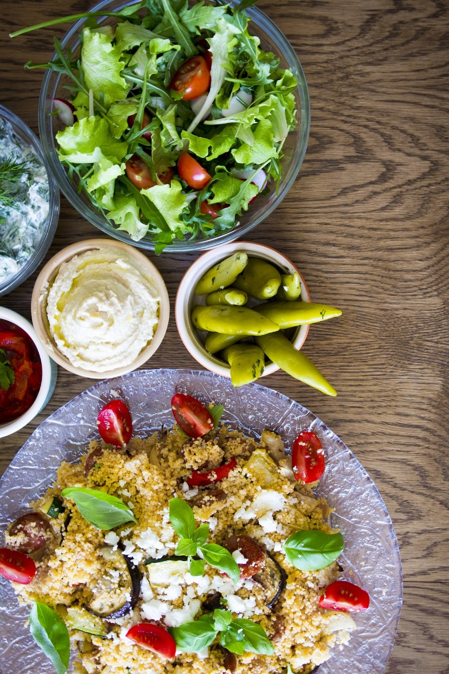
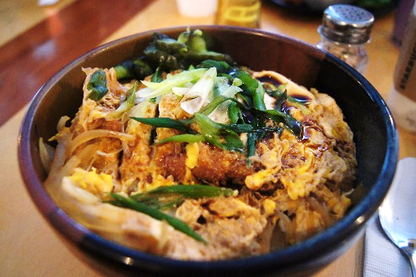
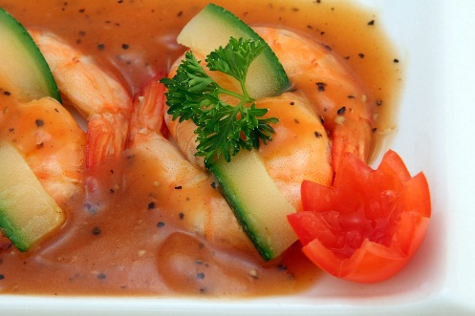
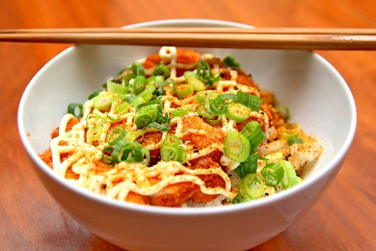
Sales Insights
Microsoft
Access Database
Domino’s
35
Top food items each month
minute
Restaurant-wise performance
McDonald’s
20
Gold Members vs Regular behavior
minute

Slide 13


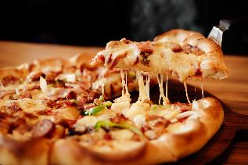
Cancellations Analysis
Microsoft
Access Database
short description
Identify restaurants with high cancellations
Find payment modes with least issues
Track overall cancellation %

Slide 14



Growth Trends
Microsoft
Access Database
Month-wise revenue tracking
Compare January → April sales
Show overall business growth
35
Trends

Slide 15
Customer Segmentation
Microsoft
Access Database
135+
2449
Gold Members: Higher frequency & discounts
Regular Members: Baseline sales
Identify loyalty program effectiveness
KFC
PizzaHut
186
$20
McDonald’s
Domino’s
Segmentation

Slide 16

Restaurant Performance
Microsoft
Access Database
Compare partner restaurants
Detect underperforming outlets
Optimize commissions

Slide 17
Payment Trends
Microsoft
Access Database
short description
Cash, Card, UPI, Wallet analysis
Reliability vs Cancellations
Customer preference insights

Slide 18


Access Features Used
Microsoft
Access Database
short description
Crosstab Queries (Trends)
Append & Union Queries (Data merge)
Group By Queries (Segmentation)
Macros (Automation)
AutoNumber IDs (Unique orders)
Locked Tables (Protection)
Access
$ 321 usd
Access
$ 321 usd

Slide 19
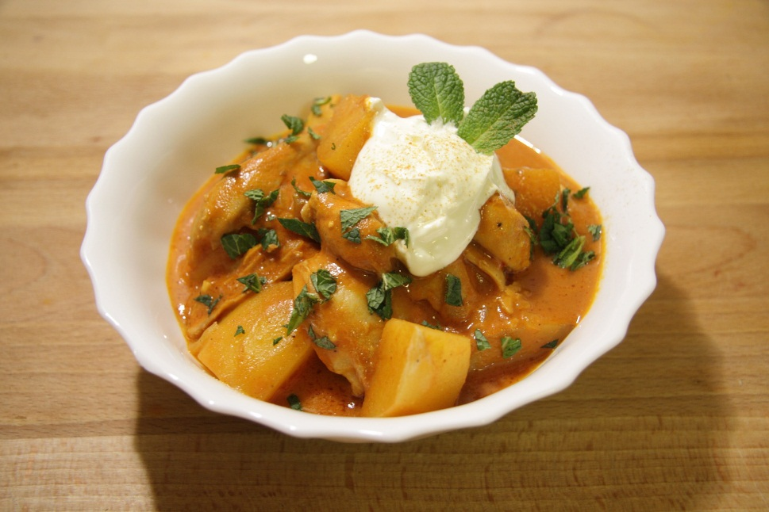
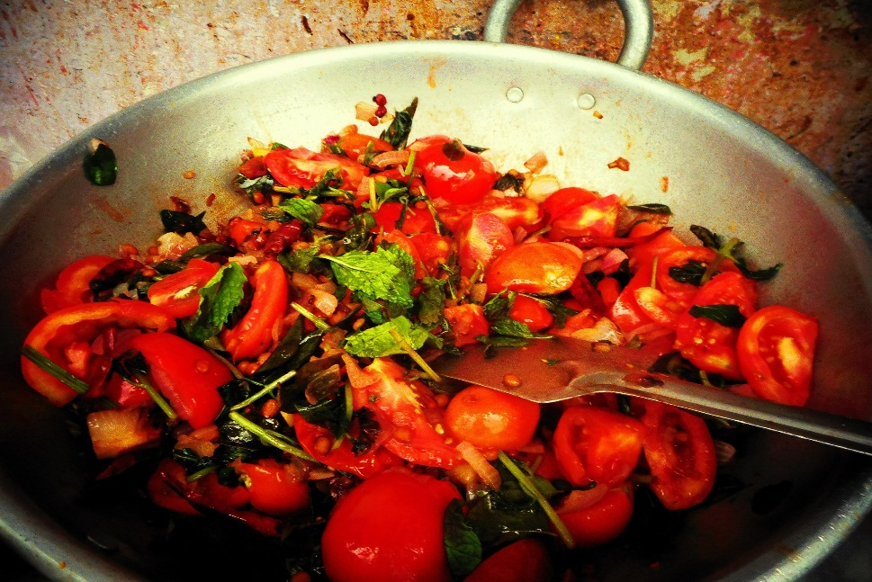
Forms & Reports
Microsoft
Access Database
35
User-friendly Forms: Add Orders, Customers, Restaurants
minute
Quick search (Order ID, Date)
20
Reports: Sales, Payments, Cancellations, Loyalty
minute

Slide 20
Deliverables
Microsoft
Access Database
Description
Master Data: Food, Customers, Restaurants
Monthly Transactions (Jan–Apr)
Final All Orders dataset
Queries for analysis
Reports for management
Macros for automation

Slide 21
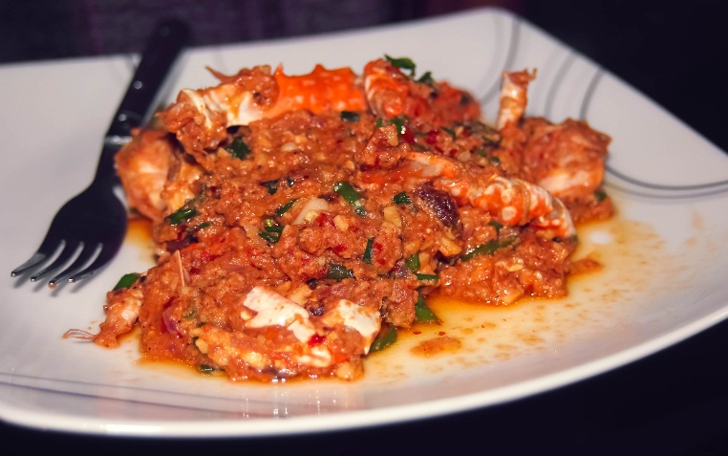
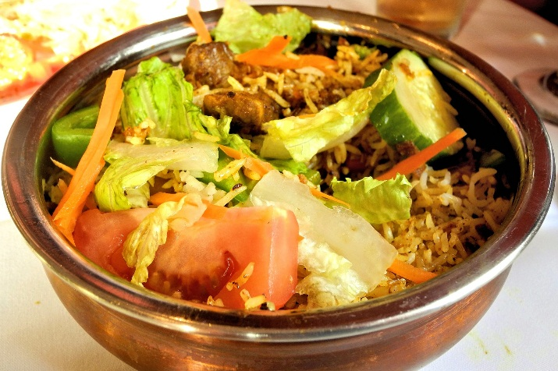
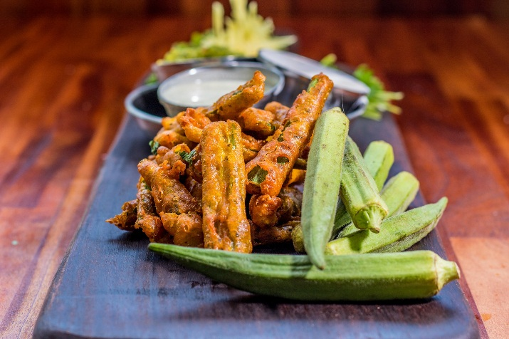
Final Results
Microsoft
Access Database
01
02
03
04
Complete company-level DBMS
Realistic data & business insights
Automated, error-free, reliable
Ready-to-use for food delivery businesses

Slide 22





Closing
Microsoft
Access Database
YOUR LOGO
SmartBite proves the power of Microsoft Access
From raw orders → to automated insights
short
description
Practical
Scalable
Company-level

Slide 23
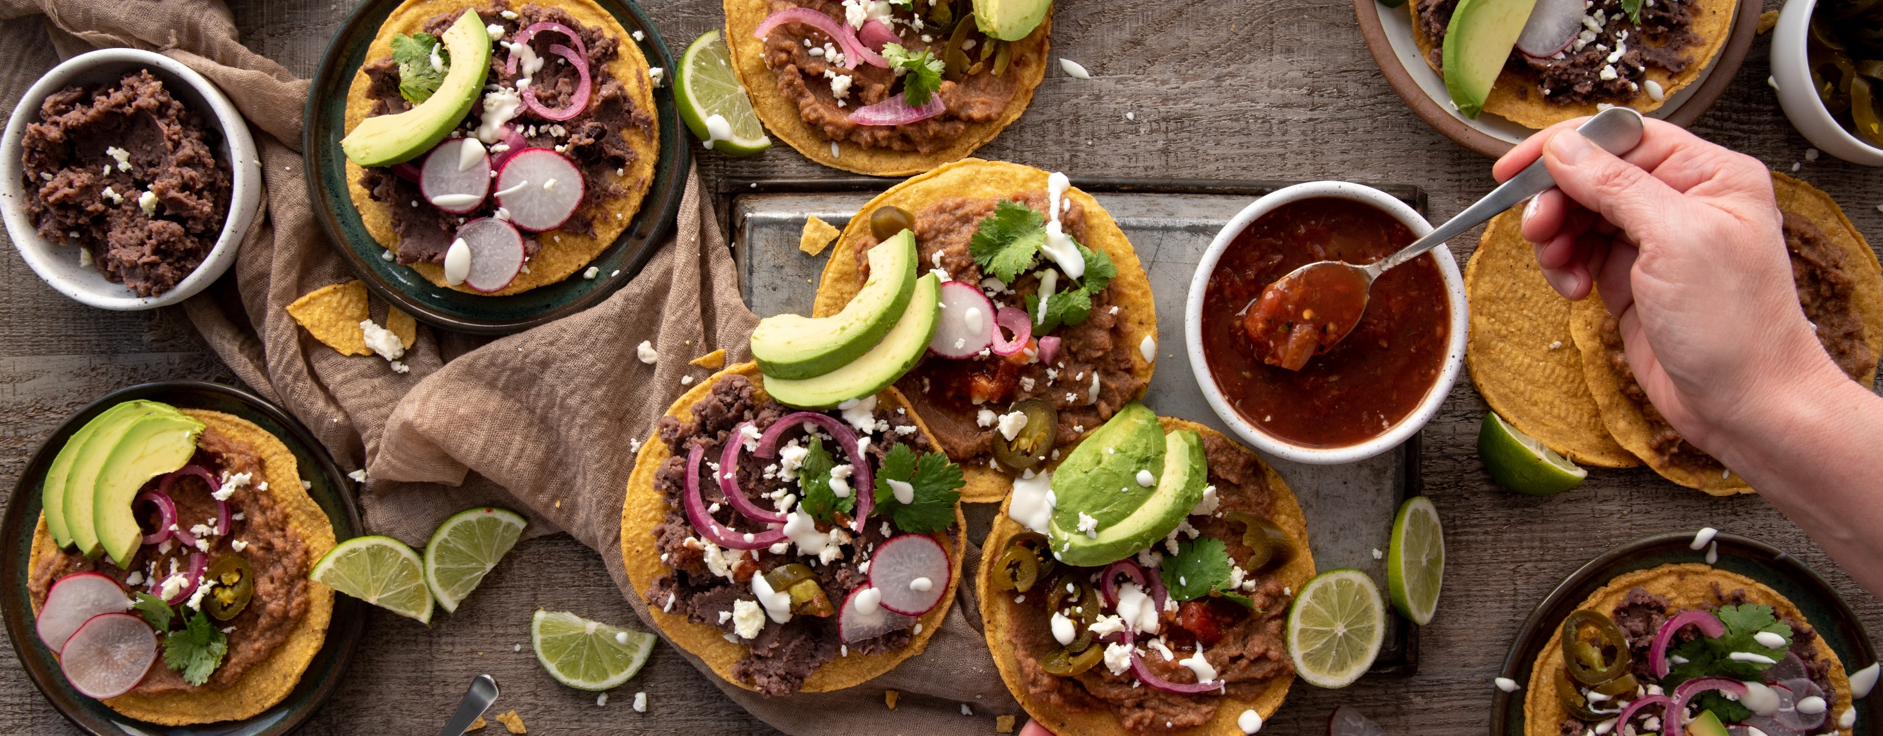


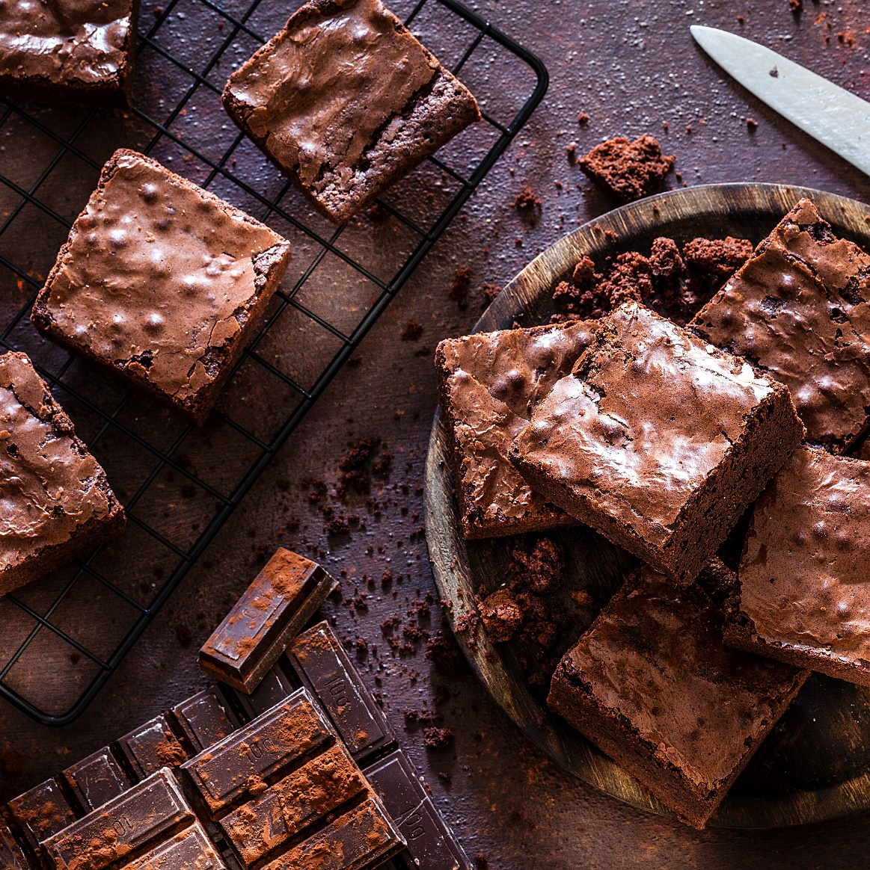
Delicious Choices, Managed Smartly
Microsoft
Access Database
YOUR LOGO

Slide 24
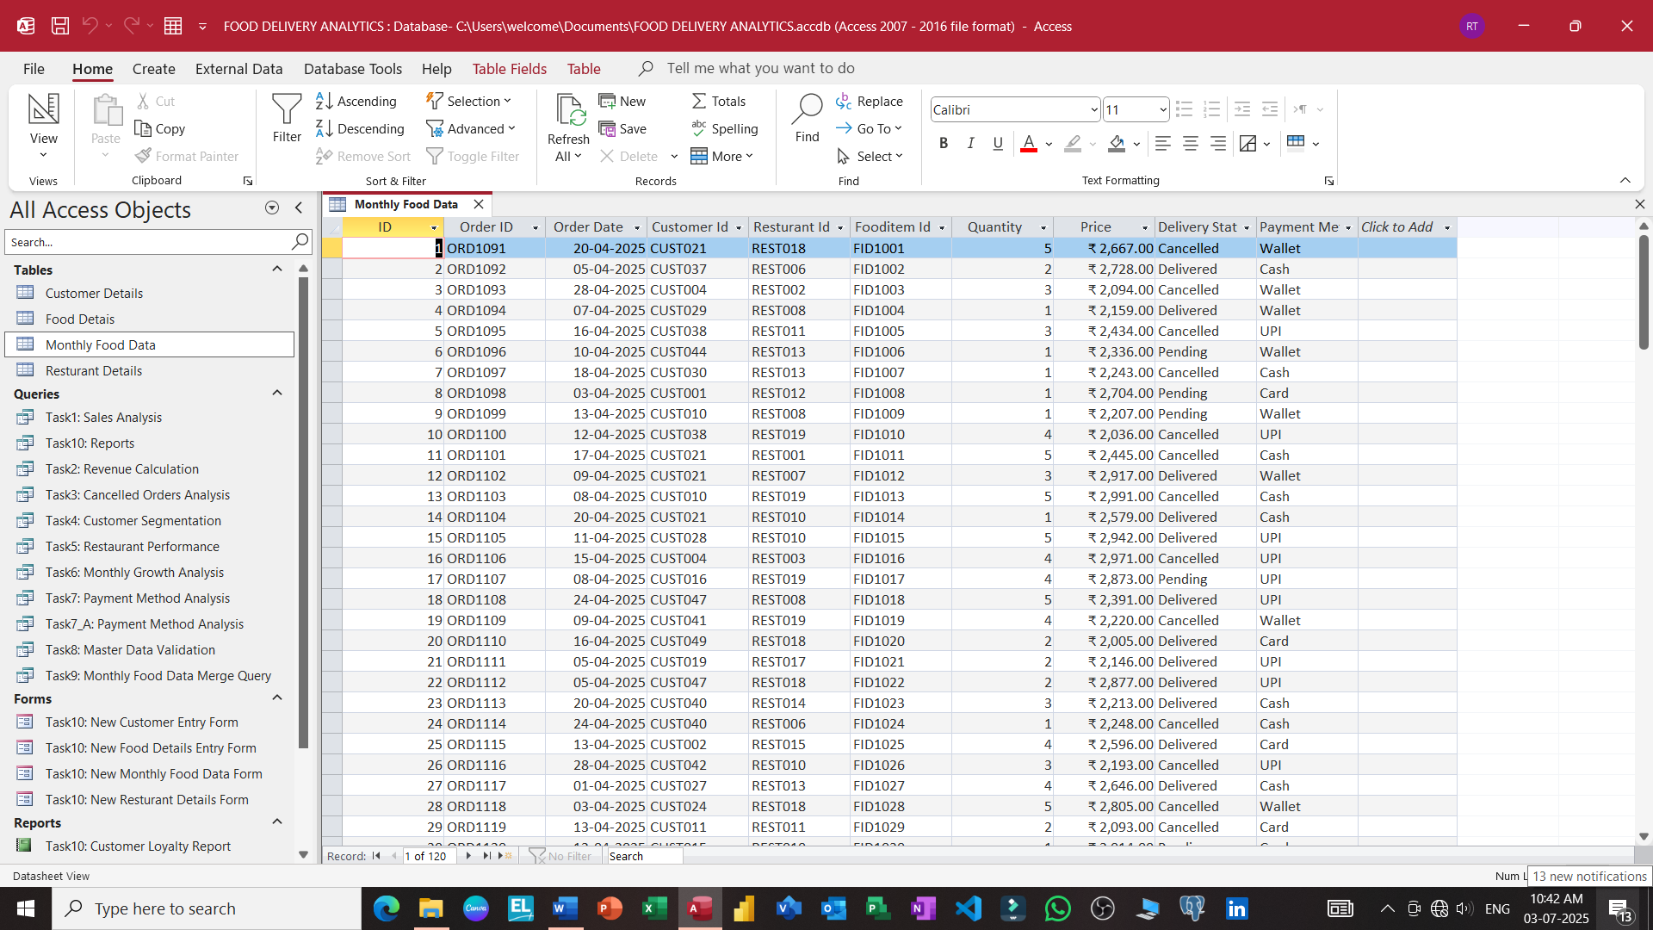

Slide 25
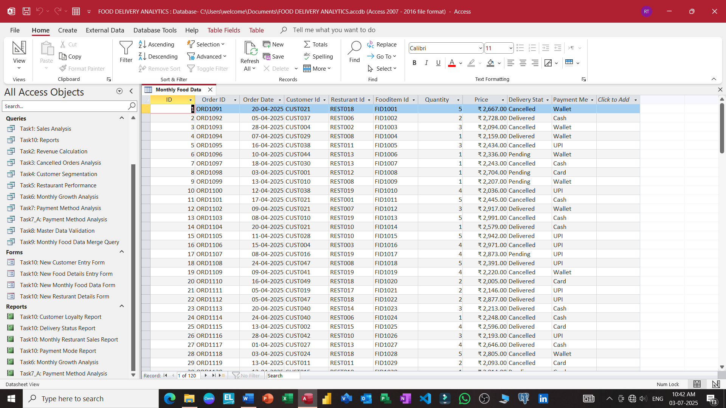

Slide 26
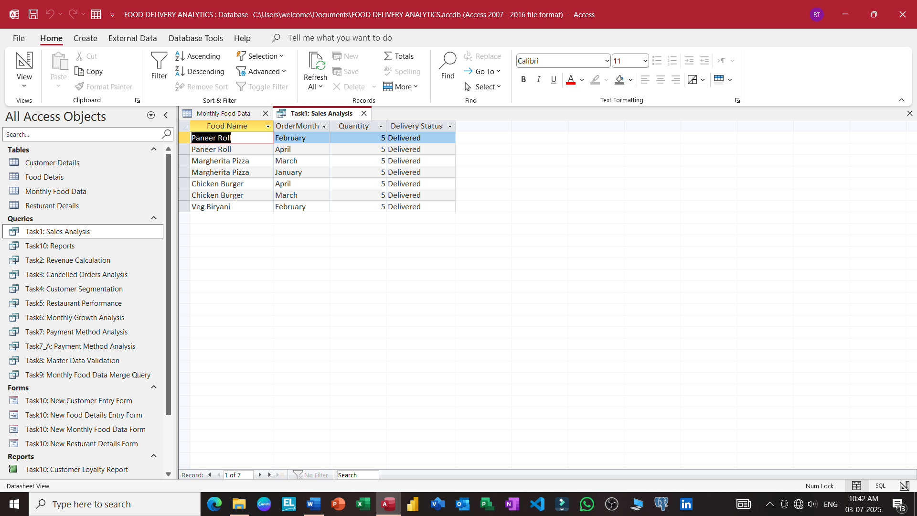

Slide 27
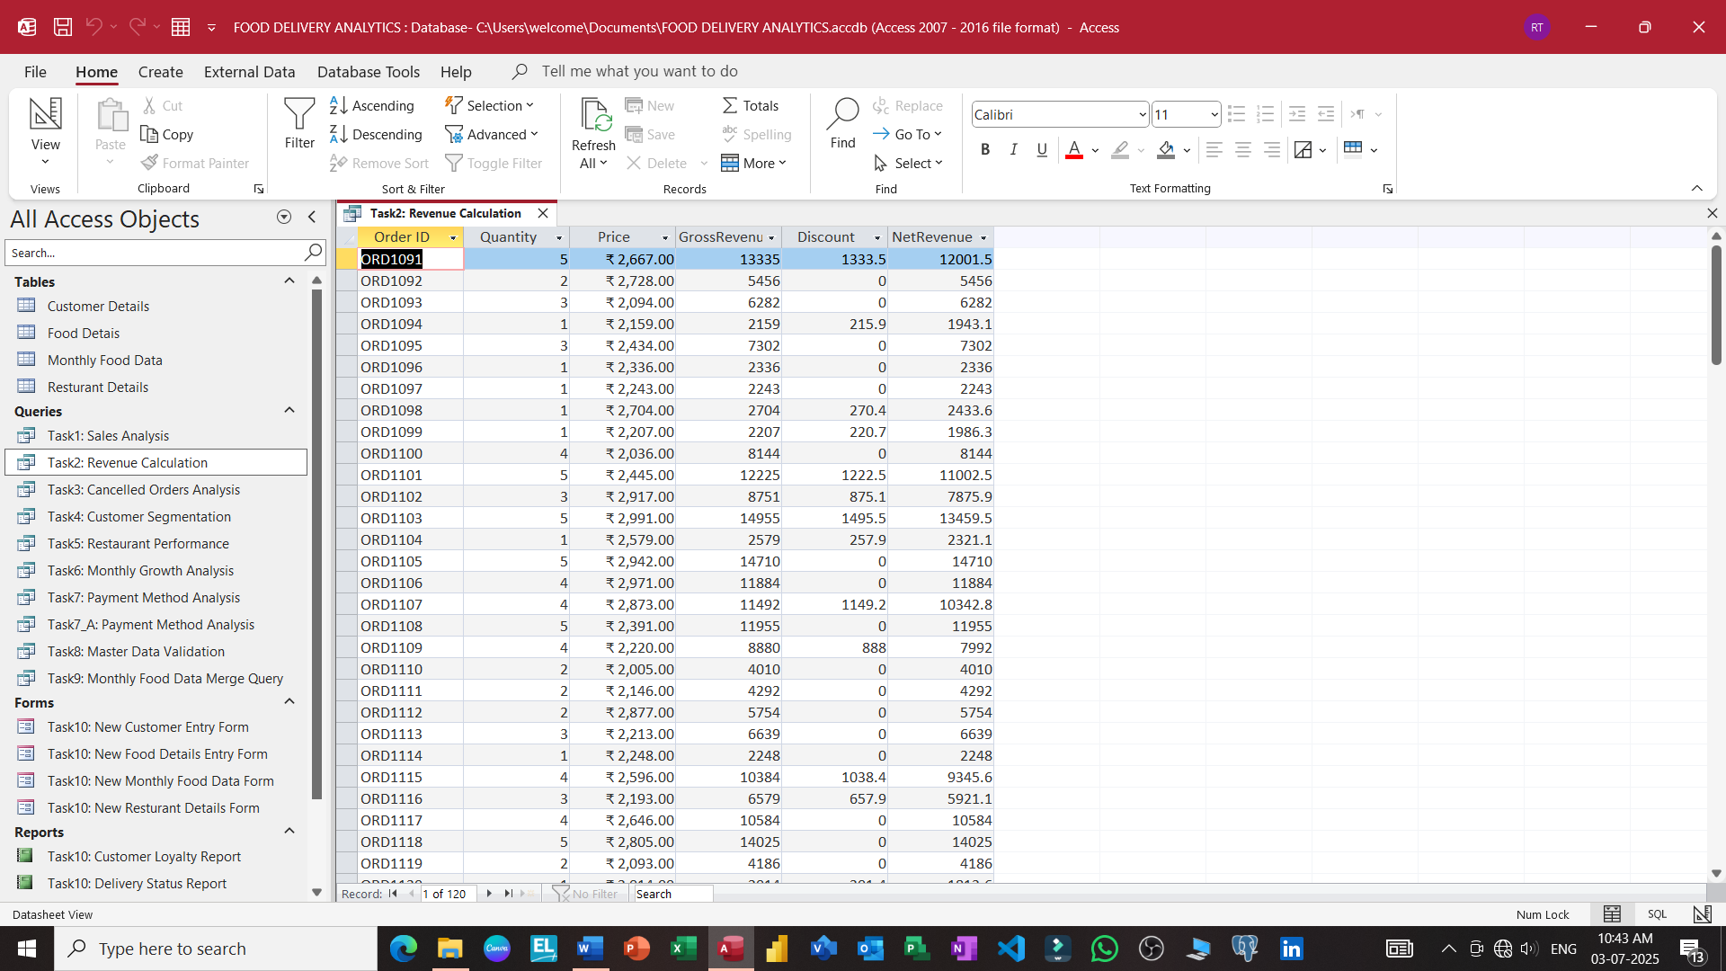

Slide 28
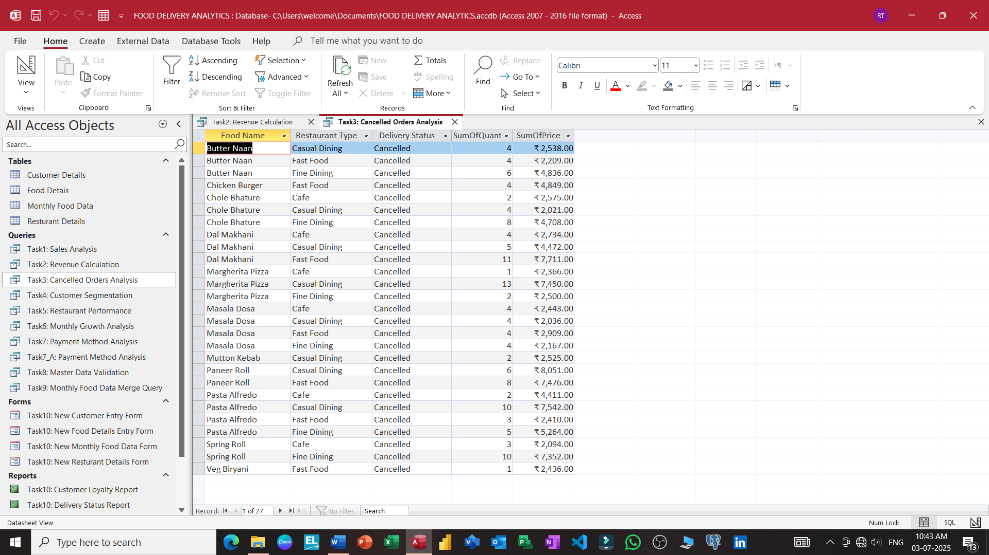

Slide 29
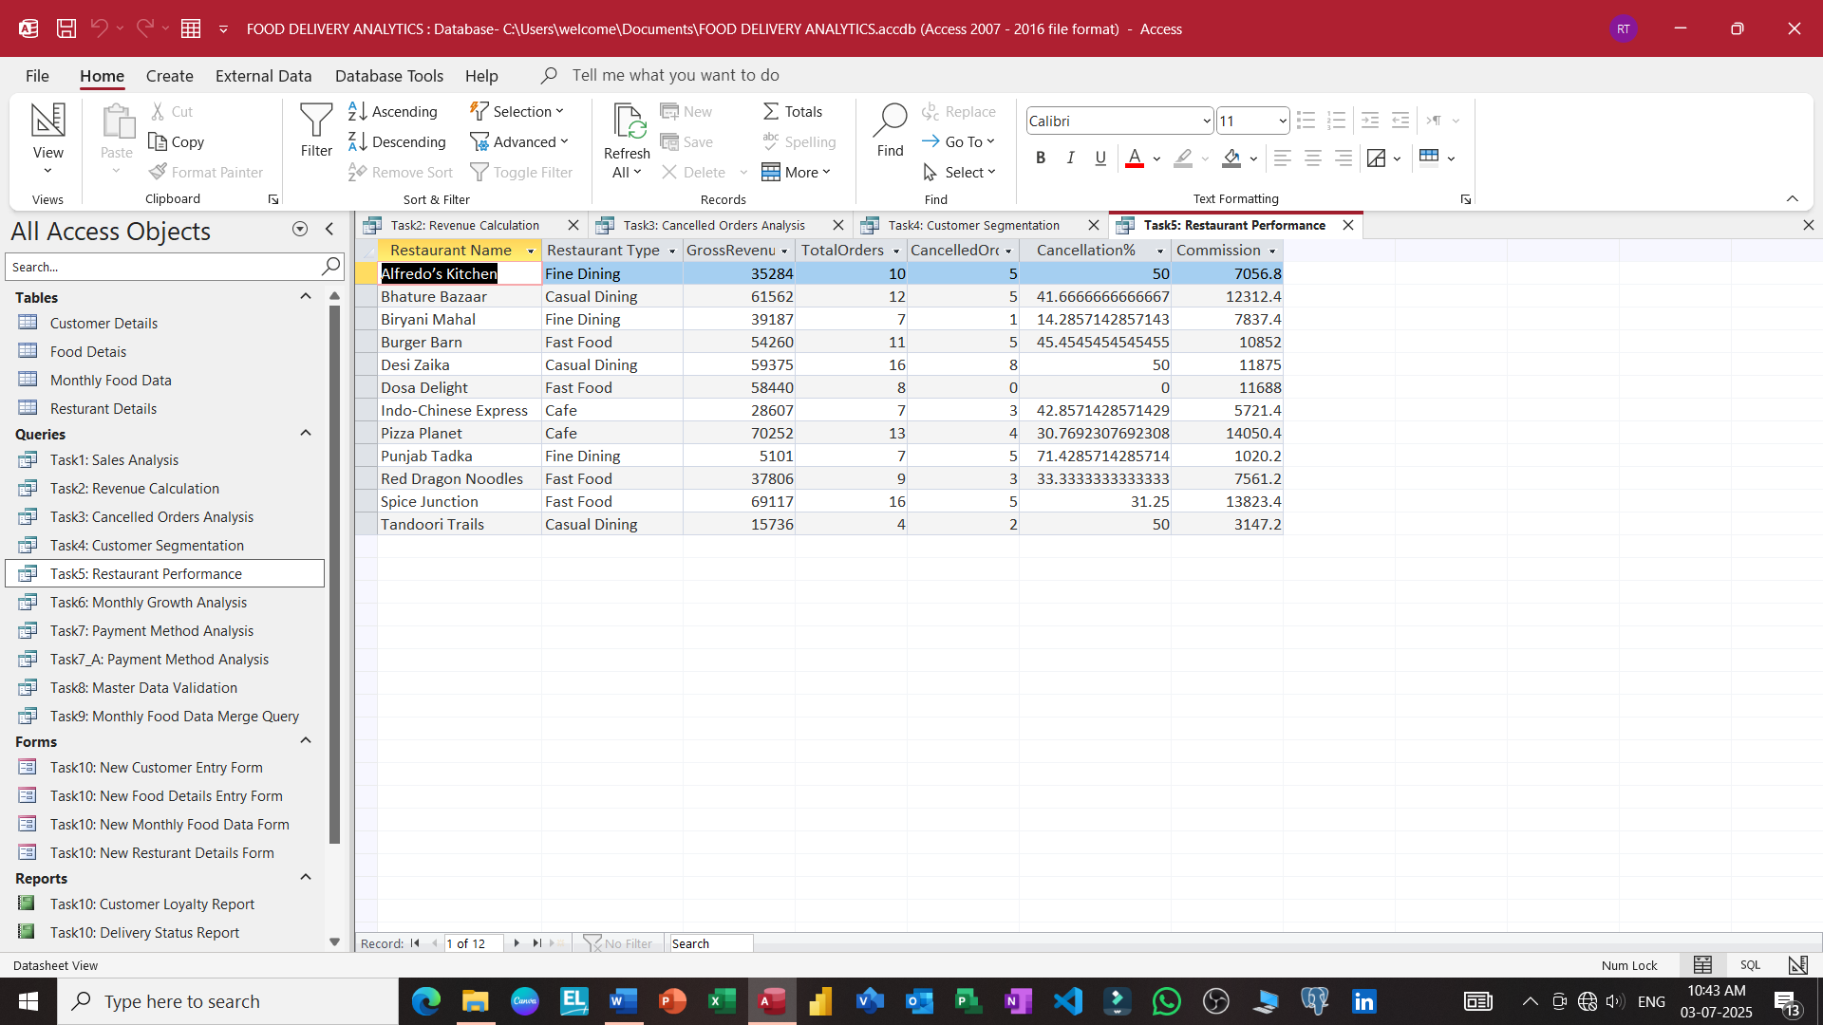

Slide 30
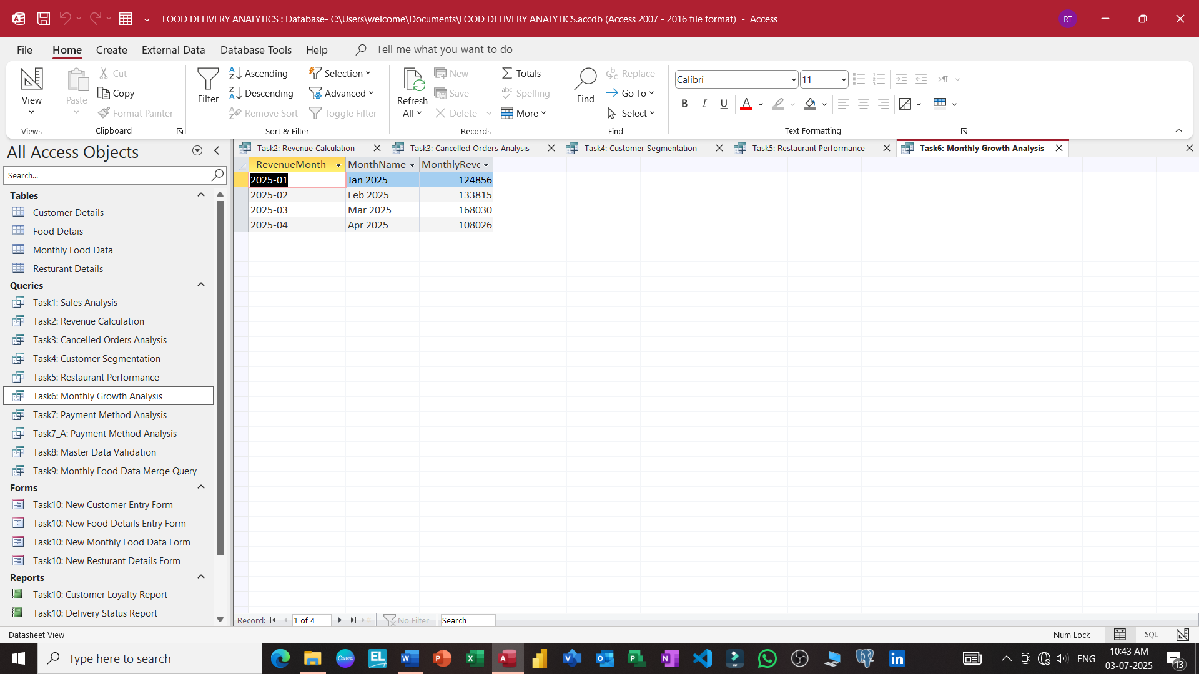

Slide 31
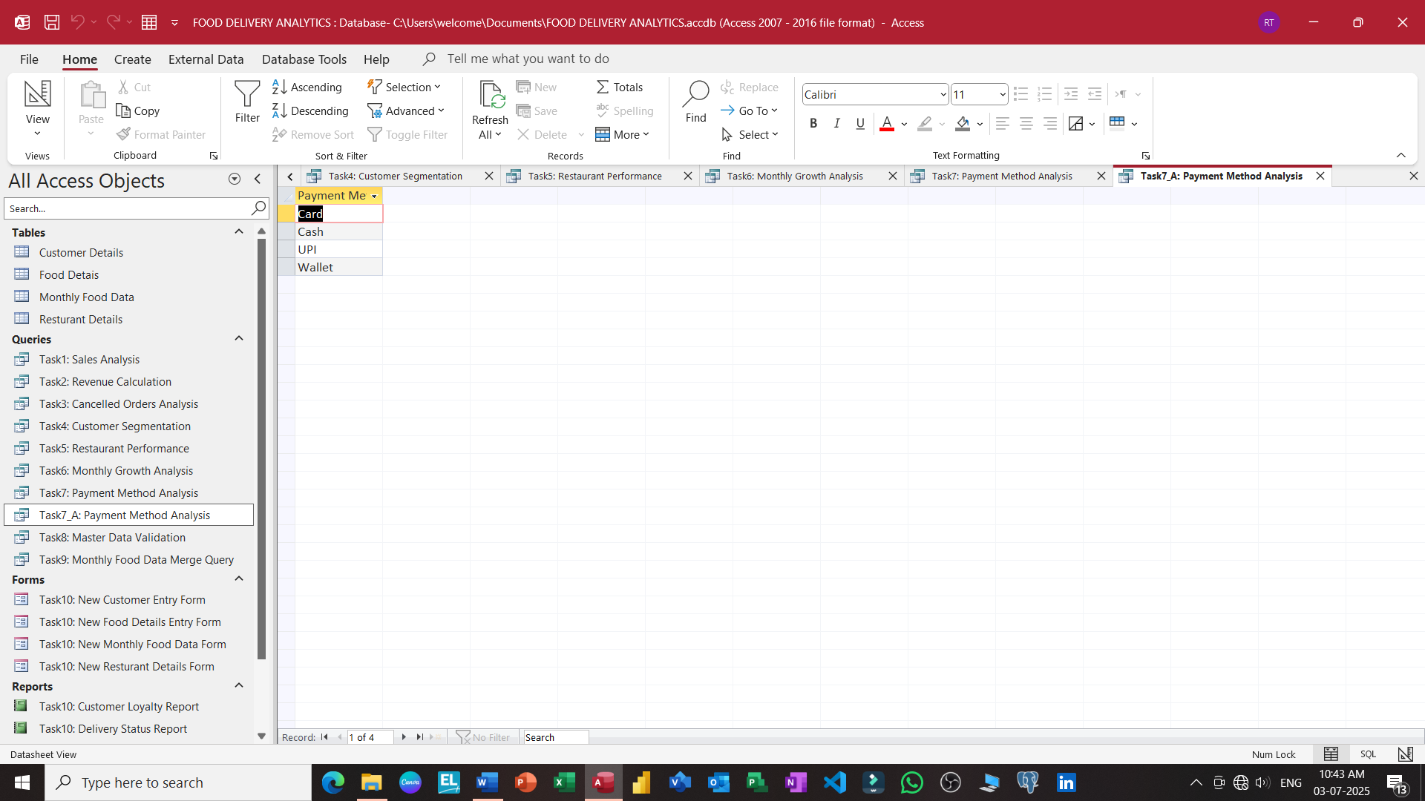

Slide 32
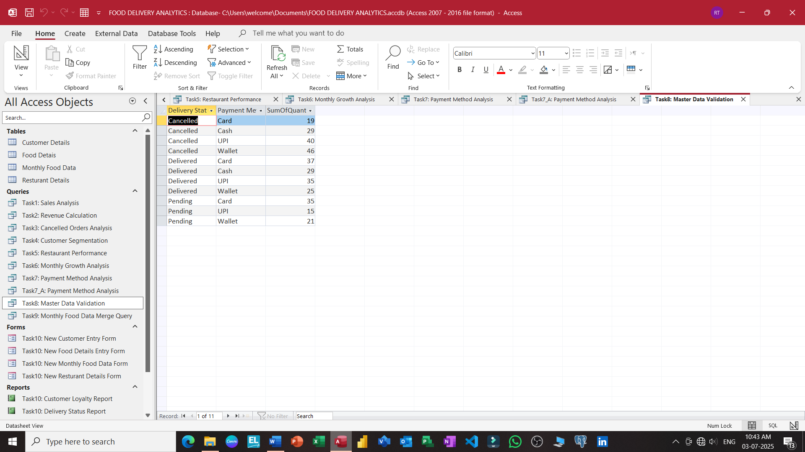

Slide 33
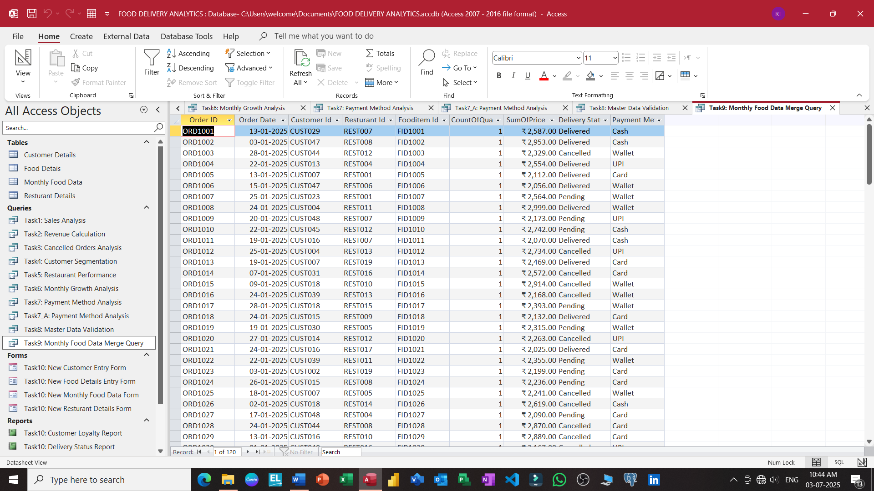

Slide 34
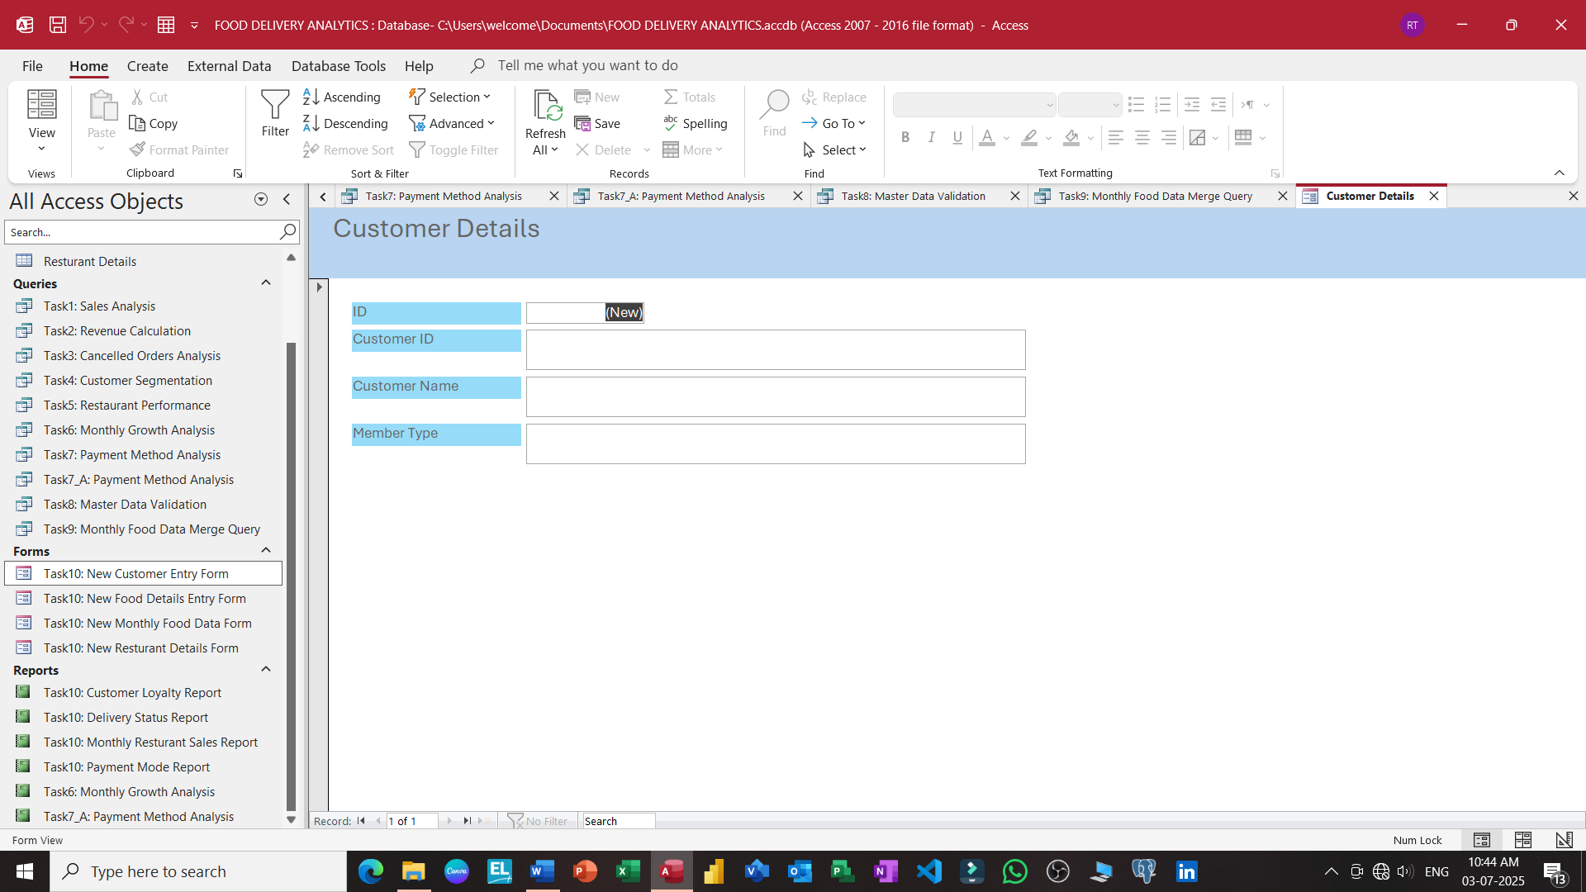

Slide 35
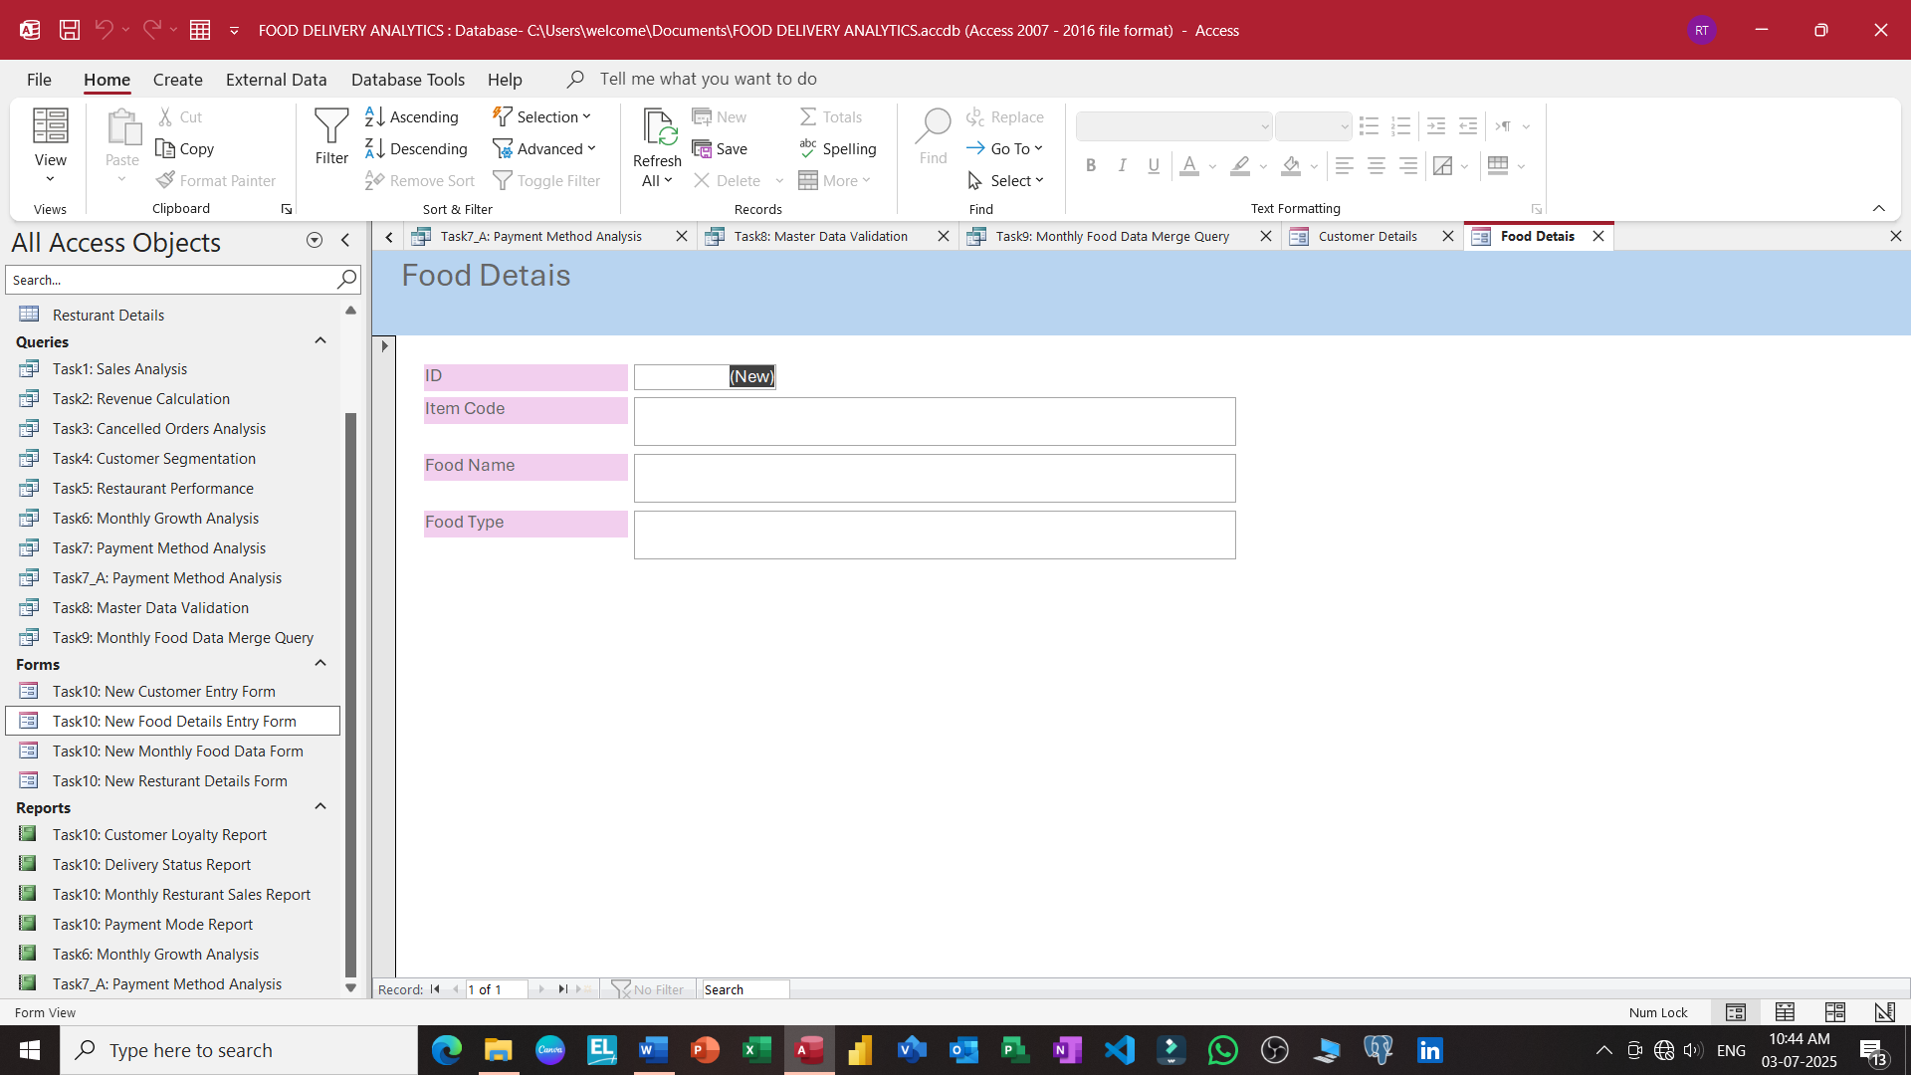

Slide 36
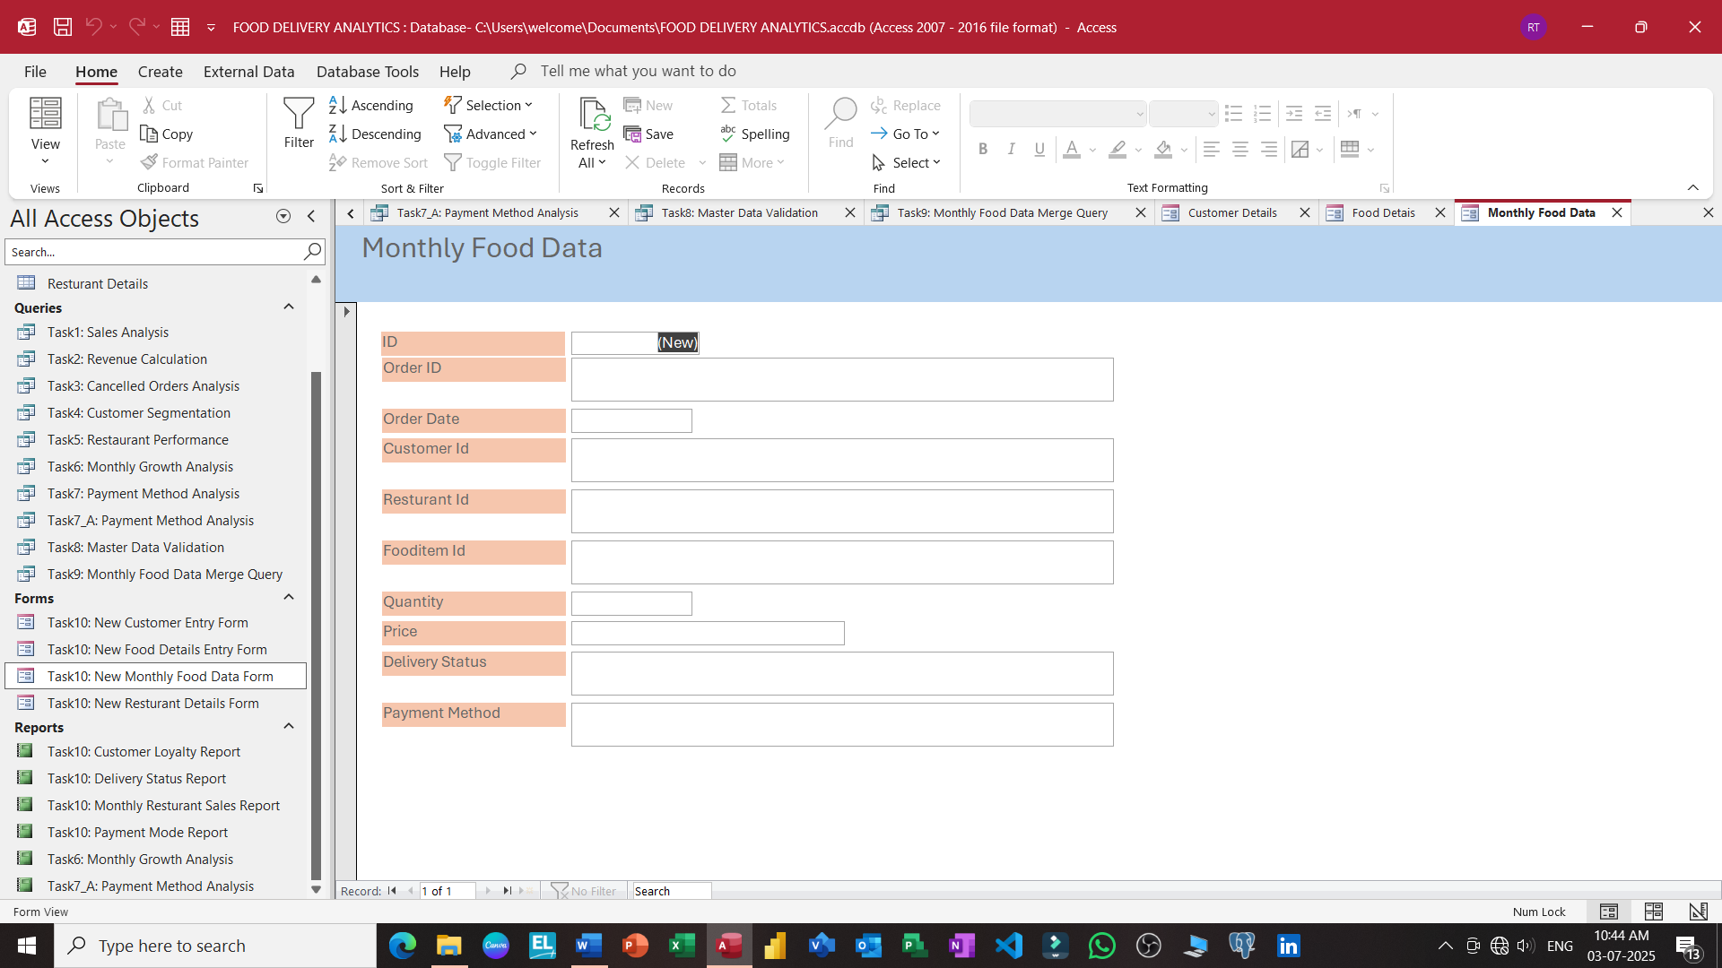

Slide 37
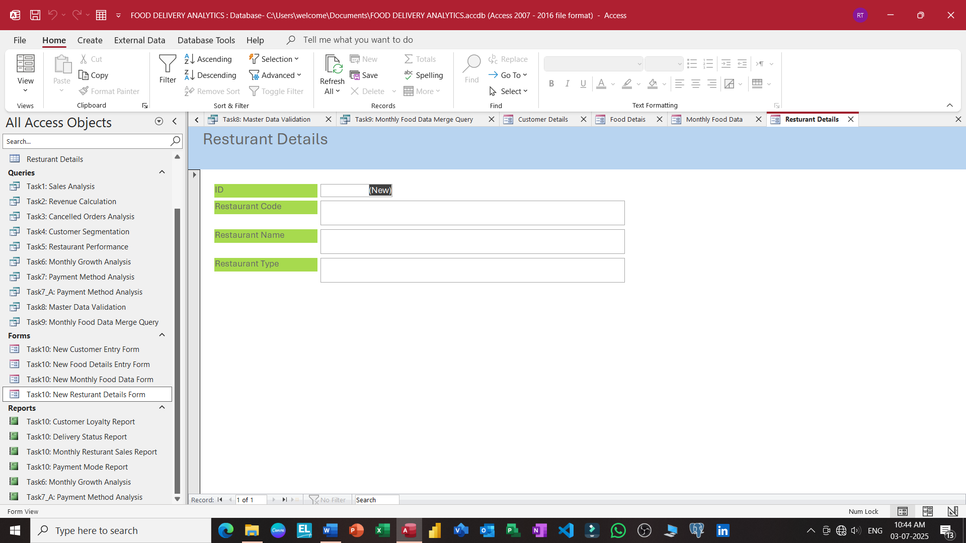

Slide 38
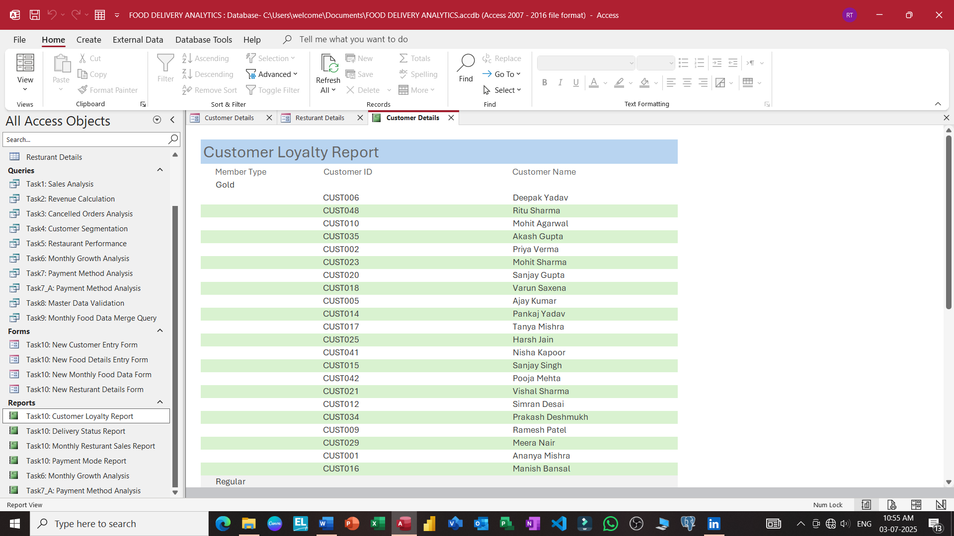

Slide 39
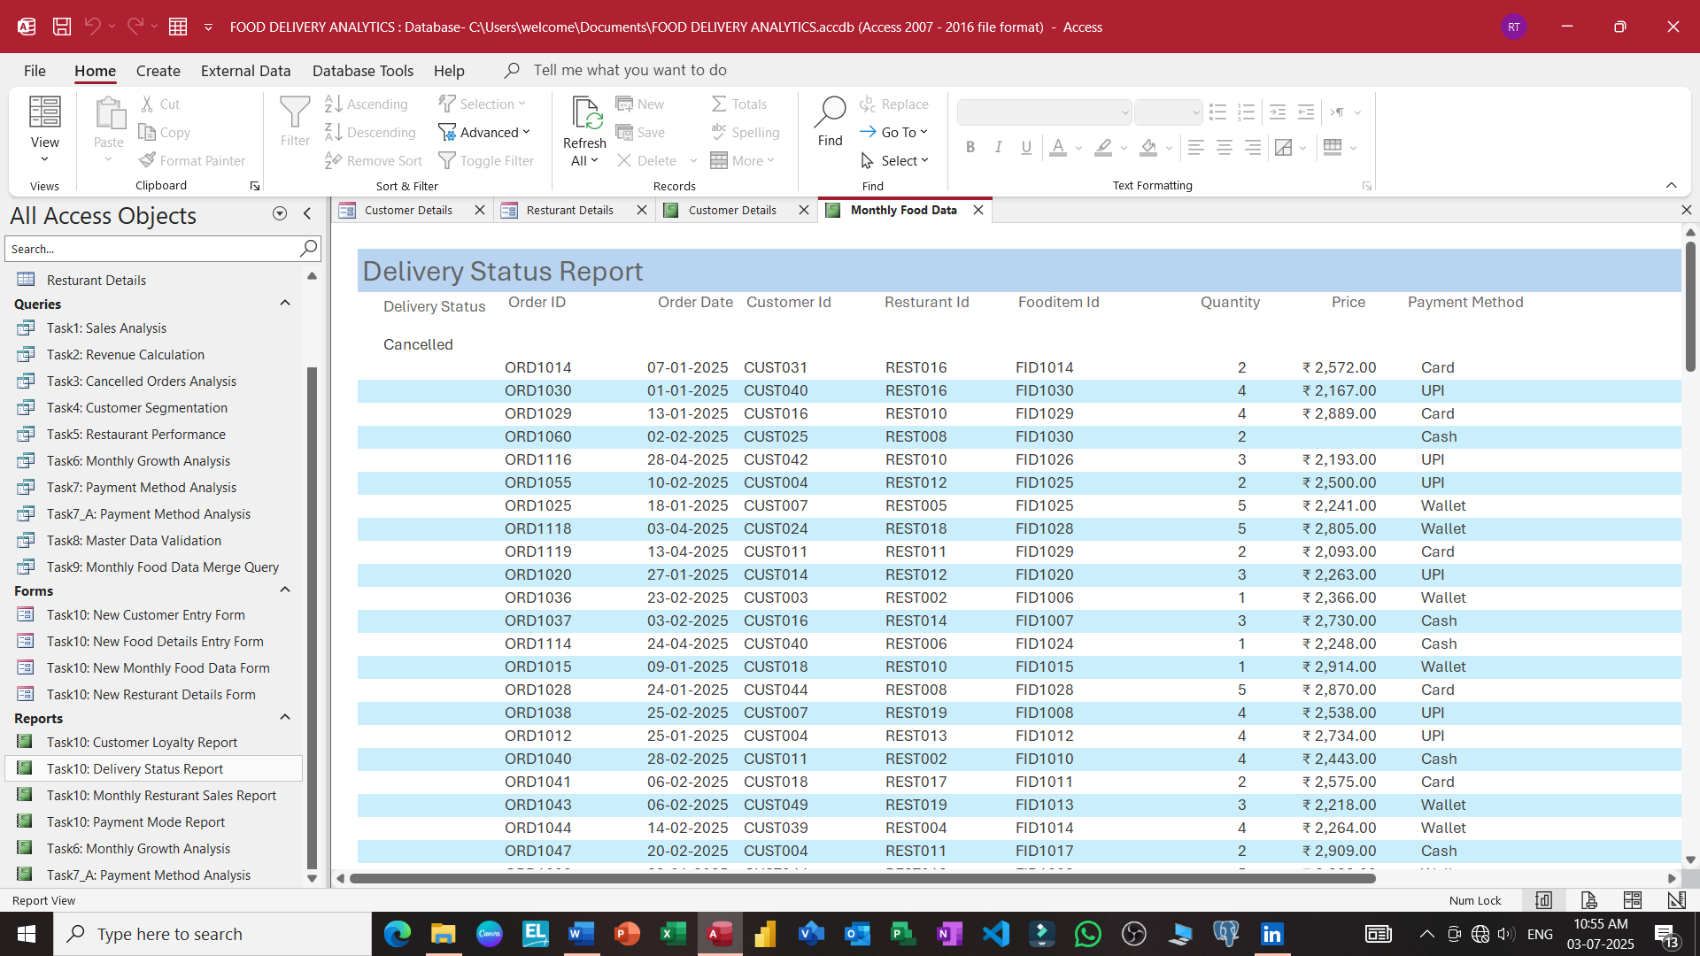

Slide 40
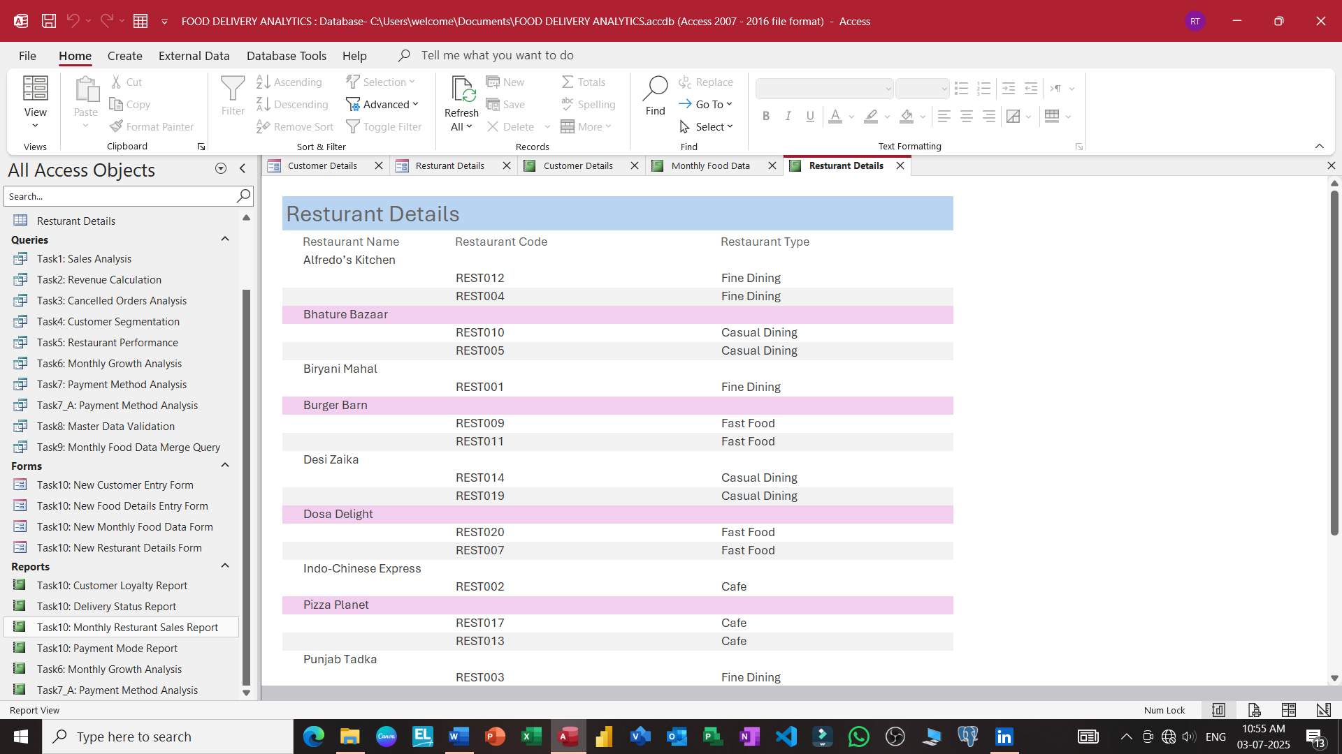

Slide 41
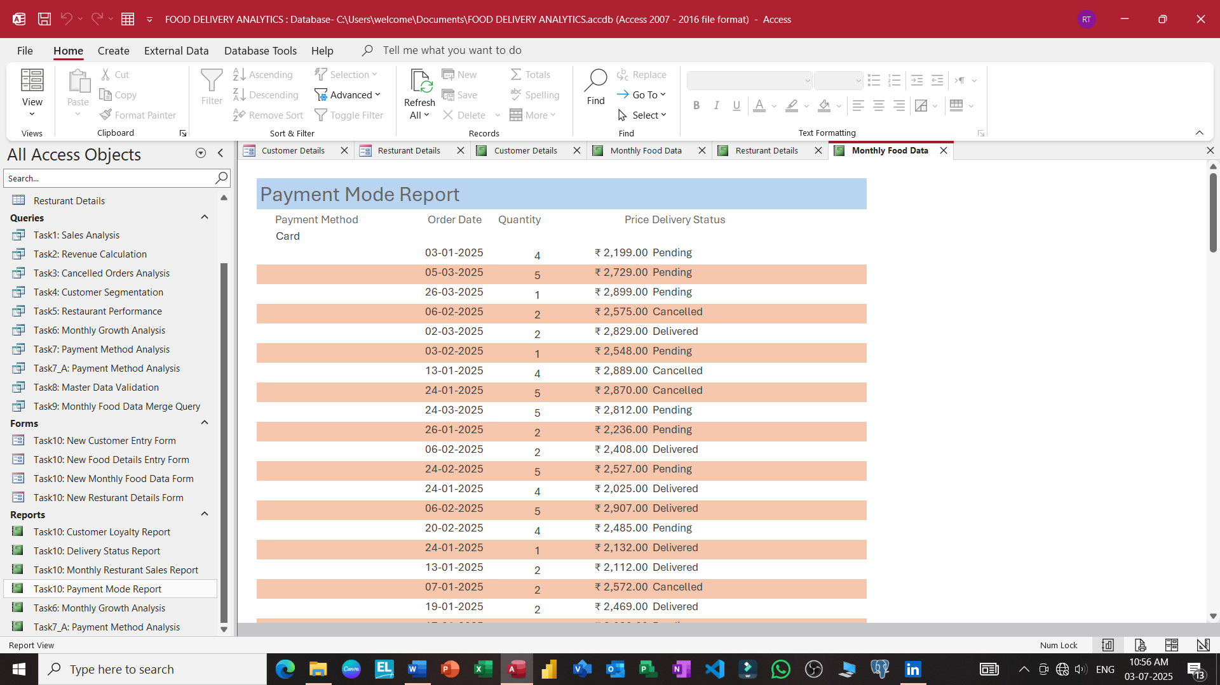

Slide 42
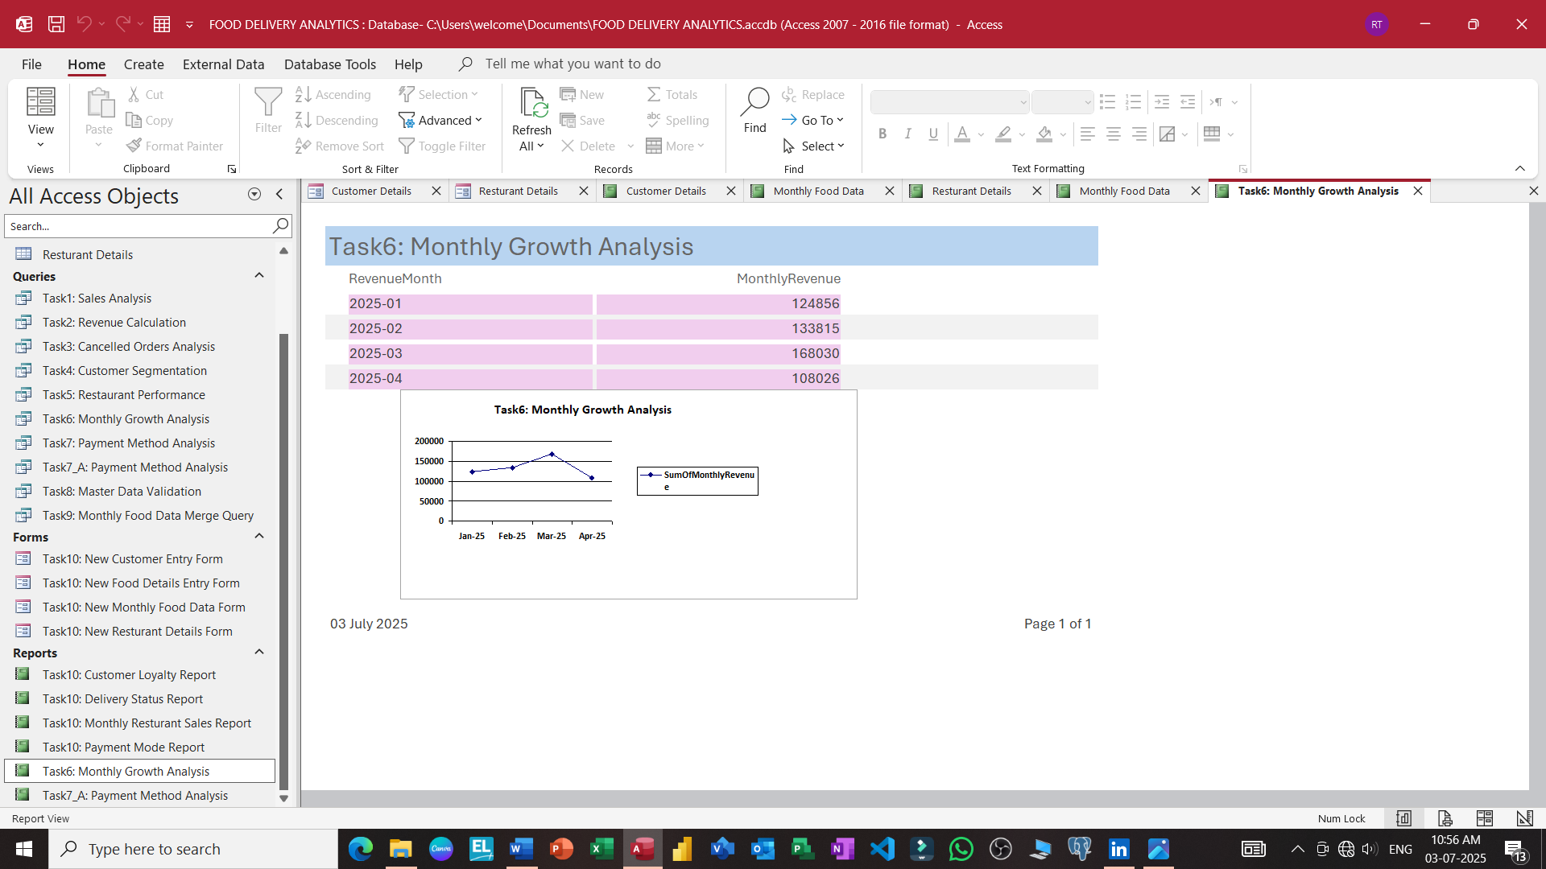

Slide 43
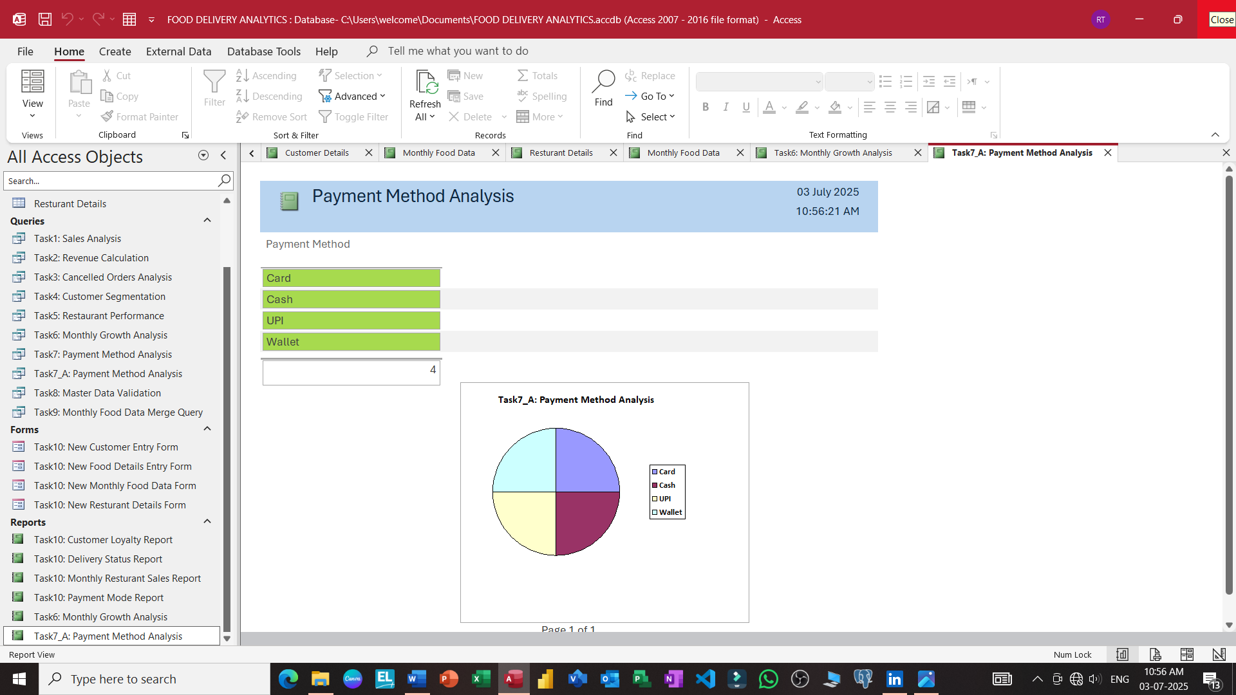

Slide 44

Microsoft
Access Database
THANKS
FOR
WATCHING
01
02
03
Every great presentation is complete with a great audience — and that’s you!

